Slide 1
How Deep Agents Remember Without Keeping Everything in Context
Jess Weng

Slide 2
What do we mean by
“Agent Memory”
Short-term memory | Long-term memory
What's in context right now | What persists across sessions

Slide 3
What do we mean by
“Agent Memory”
Context Engineering!

Slide 4
Retrieval Methods:
Context Window
RAG
(vector search)
Filesystem search
(ls, glob, grep, read_file)
Skills
Subagent as retriever

Slide 5
Beyond Retrieval:
Offloading
Summarization
Subagents
Long-term memory

Slide 6
Context Engineering:
RAG
(vector search)
Offloading
Filesystem search
(ls, glob, grep, read_file)
Summarization
Subagents
Skills
Long-term memory
Subagent as retriever

Slide 7

Skills
Tools
Memory
Context
System Prompt
Subagents
Agent = model + harness

Slide 8

Skills
Tools
Memory
Context
System Prompt
Subagents
Agent = model + harness
LLM

Slide 9
Skills
Tools
Memory
Context
System Prompt
Subagents
Agent = model + harness

Slide 10
Skills
Tools
Memory
Context
System Prompt
Subagents
Agent = model + harness

Slide 11
Skills
Tools
Memory
Context
System Prompt
Subagents
What is the job of a harness?

Slide 12

Skills
Tools
Memory
Context
System Prompt
Subagents
What is the job of a harness?
To get
the model
the right context
at the right time
for the given
task.

Slide 13
Skills
Tools
Memory
Context
System Prompt
Subagents
What is the job of a harness?
To get
the model
the right context
at the right time
for the given
task.

Slide 14
What is Deep Agents?
Agent
=
Model
+
DA Harness
Harness

Slide 15
Deep Agent
Agent
What is Deep Agents?
A customizable agent harness purpose built for complex, real-world tasks.

Slide 16
Why Deep Agents?
01
02
Provider agnostic
Highly customizable

Slide 17
Why Deep Agents?
01
02
Provider agnostic
Highly customizable

Slide 18
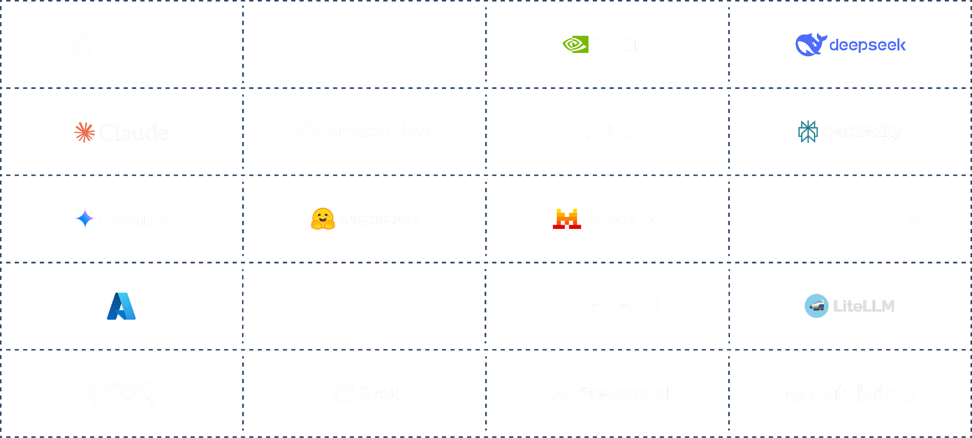
Provider agnostic

Slide 19
Why Deep Agents?
01
02
Provider agnostic
Highly customizable

Slide 20
Base Deep Agents harness
Execution Environment
Code Interpreter
Sandbox
Filesystem
Anatomy of a harness

Slide 21
Base Deep Agents harness
Execution Environment
Code Interpreter
Sandbox
Filesystem
Skills
Memory
Summarization
Context offloading
Prompt caching
Context management
Anatomy of a harness

Slide 22
Base Deep Agents harness
Execution Environment
Delegation
Code Interpreter
Sandbox
Filesystem
Planning
Subagents
Skills
Memory
Summarization
Context offloading
Prompt caching
Context management
Anatomy of a harness

Slide 23
Base Deep Agents harness
Execution Environment
Delegation
Middleware
Code Interpreter
Sandbox
Filesystem
Planning
Subagents
Human-in-the-loop
Skills
Memory
Summarization
Context offloading
Prompt caching
Context management
Anatomy of a harness

Slide 24
Base Deep Agents harness
Execution Environment
Delegation
Middleware
Code Interpreter
Sandbox
Filesystem
Planning
Subagents
Human-in-the-loop
Skills
Memory
Summarization
Context offloading
Prompt caching
Context management
Anatomy of a harness

Slide 25
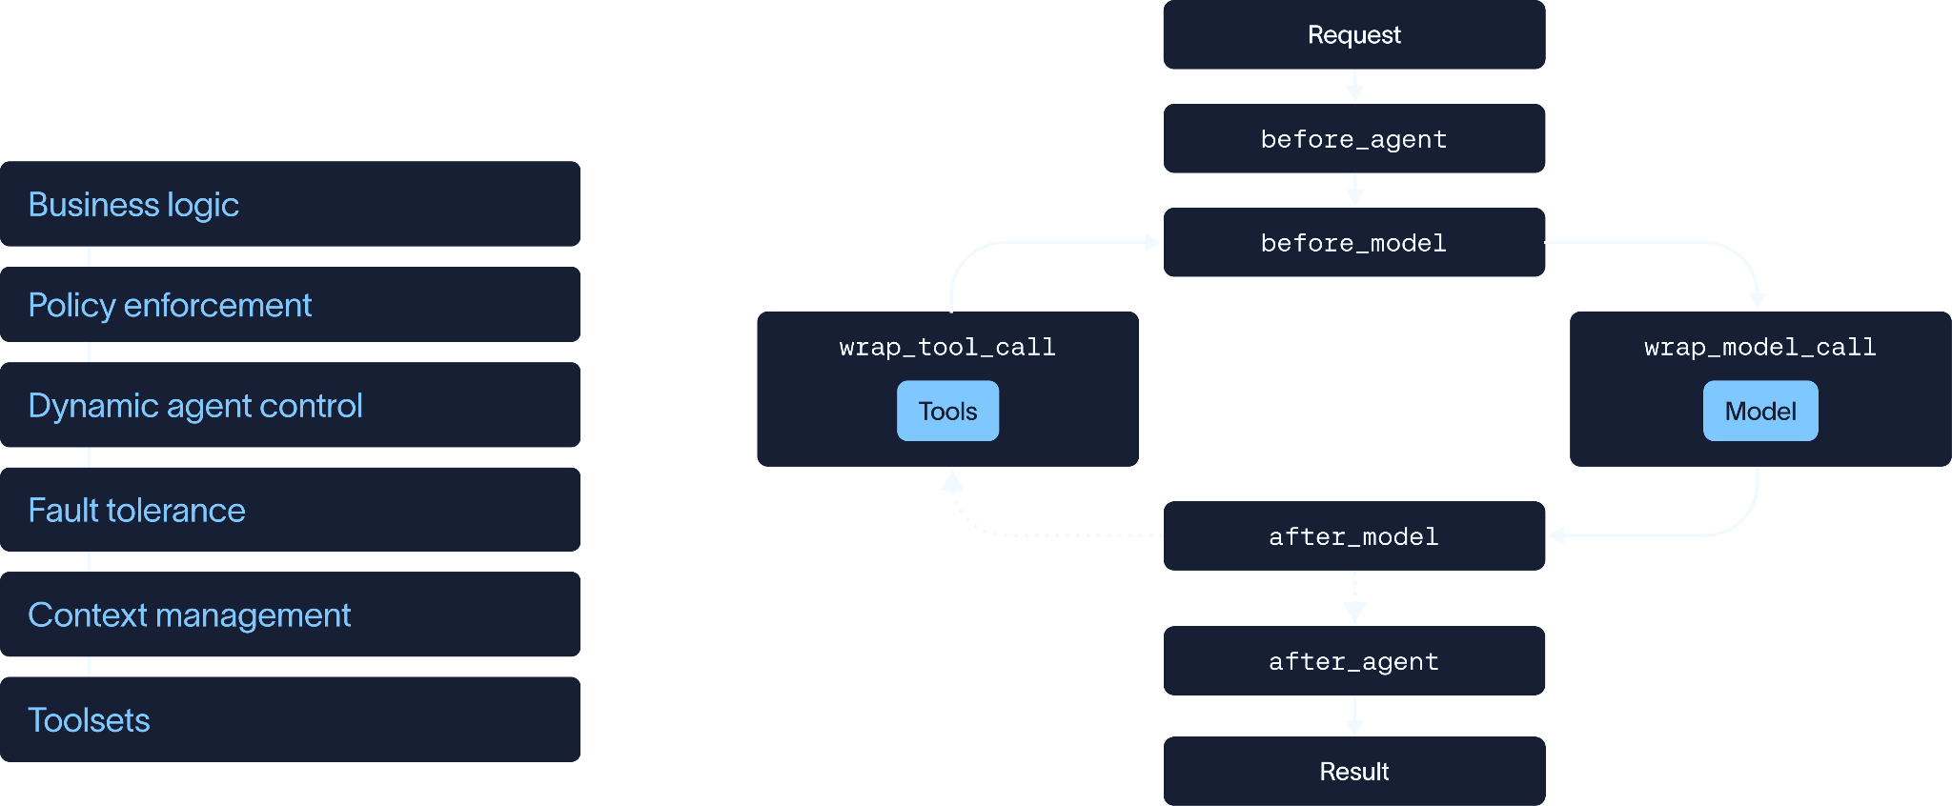
Middleware:
Hooks that allow you to customize behavior in the agent loop

Slide 26
Middleware:
Hooks that allow you to customize behavior in the agent loop

Slide 27
Middleware:
Hooks that allow you to customize behavior in the agent loop

Slide 28
Middleware:
Hooks that allow you to customize behavior in the agent loop

Slide 29
Middleware:
Hooks that allow you to customize behavior in the agent loop

Slide 30
Base Deep Agents harness
Execution Environment
Delegation
Middleware
Code Interpreter
Sandbox
Filesystem
Planning
Subagents
Human-in-the-loop
Skills
Memory
Summarization
Context offloading
Prompt caching
Context management
Anatomy of a harness

Slide 31
Middleware:
Hooks that allow you to customize behavior in the agent loop
Offloading

Slide 32
Middleware:
Hooks that allow you to customize behavior in the agent loop
Summarization

Slide 33
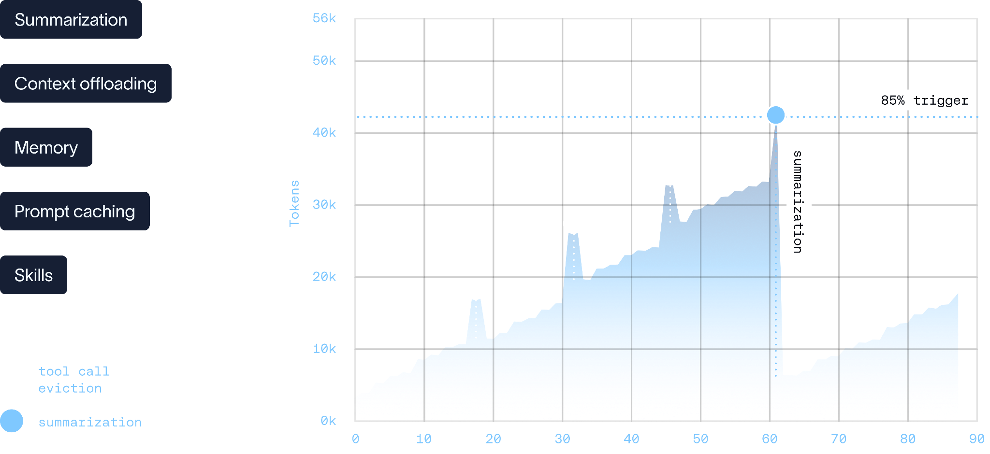
Context management

Slide 34
Context management

Slide 35
Context management

Slide 36
Context Offloading
Tool Result
(large)
> 20k tokens

Slide 37
Context Offloading
Tool Result
(large)
Filesystem Middleware
> 20k tokens

Slide 38
Context Offloading
Tool Result
(large)
Filesystem Middleware
> 20k tokens
Filesystem
PATH
/tool_results/
——————————
STATE
Full · lossless
——————————
RETRIEVE
read_file(offset,limit)

Slide 39
Context Offloading
Tool Result
(large)
Context Window
Filesystem Middleware
> 20k tokens
Preview
————————————
Row 1 | Alice…
…
→ /path/ …
Filesystem
PATH
/tool_results/
——————————
STATE
Full · lossless
——————————
RETRIEVE
read_file(offset,limit)

Slide 40
Context Offloading
Context Window
Filesystem Middleware
Preview
————————————
Row 1 | Alice…
…
→ /path/ …
Human Message
> 50k tokens
Filesystem
PATH
/conv_history/
——————————
STATE
Full · lossless
——————————
RETRIEVE
read_file(offset,limit)

Slide 41

Summarization
BEFORE
Context window

Slide 42
Summarization
BEFORE
0%
Context window

Slide 43
Summarization
BEFORE
0%
Context window
Threshold (85%)

Slide 44
Summarization
BEFORE
1%
Context window
Threshold (85%)

Slide 45
Summarization
BEFORE
2%
Context window
Threshold (85%)

Slide 46
Summarization
BEFORE
3%
Context window
Threshold (85%)

Slide 47
Summarization
BEFORE
4%
Context window
Threshold (85%)

Slide 48
Summarization
BEFORE
88%
Context window
Threshold (85%)

Slide 49
Summarization
BEFORE
88%
Context window
Threshold (85%)

Slide 50
Summarization
AFTER SUMMARIZATION
BEFORE
Context window
Context window
Summarization
(middleware)
Keep Cutoff

Slide 51
Summarization
AFTER SUMMARIZATION
BEFORE
Context window
Context window
Summary
Summarization
(middleware)
Keep Cutoff

Slide 52
Summarization
AFTER SUMMARIZATION
BEFORE
2%
Context window
Context window
Summary
Summarization
(middleware)
Keep Cutoff

Slide 53
Summarization
AFTER SUMMARIZATION
BEFORE
3%
Context window
Context window
Summary
Summarization
(middleware)
Keep Cutoff

Slide 54
Summarization
AFTER SUMMARIZATION
BEFORE
4%
Context window
Context window
Summary
Summarization
(middleware)
Keep Cutoff

Slide 55
Summarization
AFTER SUMMARIZATION
BEFORE
5%
Context window
Context window
Summary
Summarization
(middleware)
Keep Cutoff

Slide 56
Summarization
SUMMARIZED ONCE
5%
Context window
Summary
Threshold (85%)

Slide 57
Summarization
SUMMARIZED ONCE
85%
Context window
Summary
Threshold (85%)

Slide 58
Summarization
SUMMARIZED ONCE
Context window
Context window
Summary
Summary
Summarization
(middleware)
Keep Cutoff

Slide 59
Summarization
SUMMARIZED ONCE
SUMMARIZED TWICE
3%
Context window
Context window
Summary
Summary
Summarization
(middleware)
Keep Cutoff

Slide 60
Summarization
SUMMARIZED ONCE
SUMMARIZED TWICE
4%
Context window
Context window
Summary
Summary
Summarization
(middleware)
Keep Cutoff

Slide 61

Summarization
SUMMARIZED ONCE
SUMMARIZED TWICE
86%
Context window
Context window
Context window
Summary
Summary
Summarization
(middleware)
Keep Cutoff

Slide 62
Offloading vs. Summarization
Offloading | Summarization

Slide 63
Offloading vs. Summarization
Offloading | Summarization
Intercepts input before they enter context

Slide 64
Offloading vs. Summarization
Offloading | Summarization
Intercepts input before they enter context | Acts on content already in the context window

Slide 65


Offloading vs. Summarization
Offloading | Summarization

Slide 66
Base Deep Agents harness
Execution Environment
Delegation
Middleware
Code Interpreter
Sandbox
Filesystem
Planning
Subagents
Human-in-the-loop
Skills
Memory
Summarization
Context offloading
Prompt caching
Context management
Anatomy of a harness

Slide 67
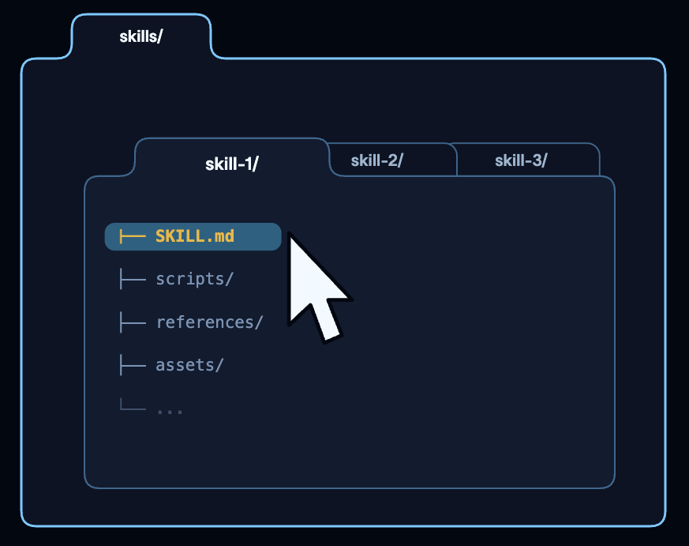
What is a skill

Slide 68
Skills
Middleware:
Hooks that allow you to customize behavior in the agent loop

Slide 69
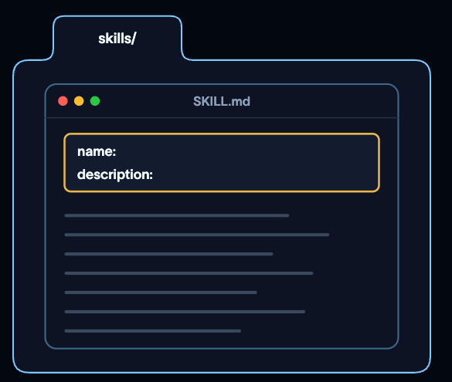
Progressive Disclosure

Slide 70
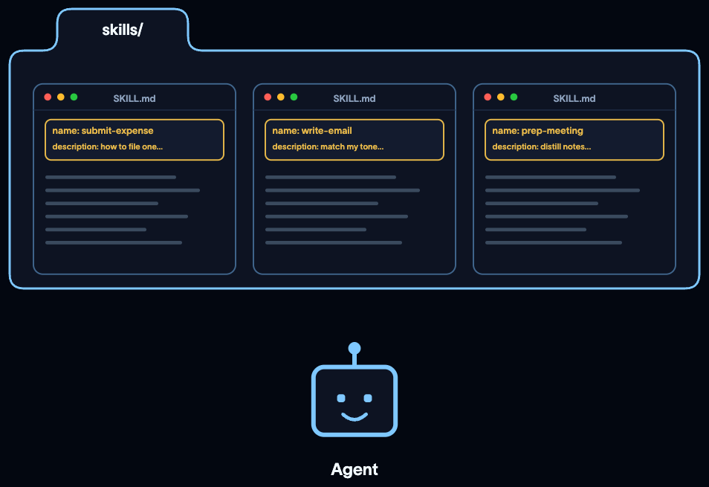
Progressive Disclosure

Slide 71
Skills
Middleware:
Hooks that allow you to customize behavior in the agent loop

Slide 72
Progressive Disclosure

Slide 73
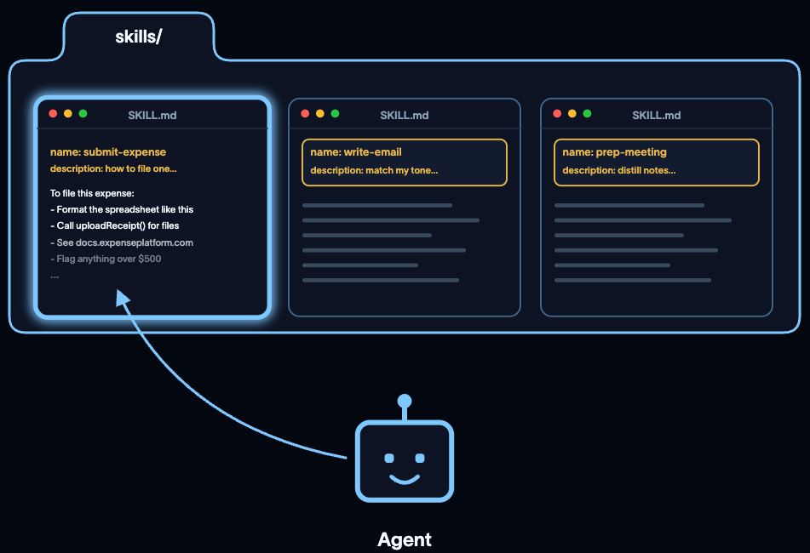
Progressive Disclosure

Slide 74
Base Deep Agents harness
Execution Environment
Delegation
Middleware
Code Interpreter
Sandbox
Filesystem
Planning
Subagents
Human-in-the-loop
Skills
Memory
Summarization
Context offloading
Prompt caching
Context management
Anatomy of a harness

Slide 75
Base Deep Agents harness
Execution Environment
Delegation
Middleware
Code Interpreter
Sandbox
Filesystem
Planning
Subagents
Human-in-the-loop
Skills
Memory
Summarization
Context offloading
Prompt caching
Context management
Anatomy of a harness

Slide 76
Subagents
input

Slide 77
Subagents
input
model

Slide 78
Subagents
input
model
context window

Slide 79
Subagents
input
model
context window
subagent
subagent

Slide 80
Subagents
input
model
context window
separate context window
subagent
subagent

Slide 81
Subagents
input
model
context window
separate context window
separate tools
subagent
subagent

Slide 82
Subagents
input
model
subagent
subagent

Slide 83
Subagents
input
model
subagent
subagent

Slide 84
Subagents
input
model
Subagent A
Subagent B

Slide 85
Subagents
input
model
Scrape web for articles
Subagent A
Subagent B

Slide 86
Subagents
input
model
Scrape web for articles
Subagent A
Subagent B
Scrape video information

Slide 87
Subagents
input
model
Subagent A
Subagent B
tool
tool

Slide 88
Subagents
input
model
Subagent A
Subagent B
tool
tool

Slide 89
Subagents
input
model
Subagent A
Subagent B
tool
tool

Slide 90
Subagents
input
model
Subagent A
Subagent B
tool
tool

Slide 91
Subagents
input
model
Subagent A
Subagent B
tool
tool

Slide 92
Subagents
input
model
Subagent A
Subagent B
tool
tool
output

Slide 93

Model
Subagent

Slide 94



Model
Subagents

Slide 95
Everything we just looked at so far:
Short-term memory
So what lasts across conversations?

Slide 96
Base Deep Agents harness
Execution Environment
Delegation
Middleware
Code Interpreter
Sandbox
Filesystem
Planning
Subagents
Human-in-the-loop
Skills
Memory
Summarization
Context offloading
Prompt caching
Context management
Anatomy of a harness

Slide 97

Long-term memory
memory=["/memories/AGENTS.md"]
AGENTS.md

Slide 98
Long-term memory
Loaded at the start (before_agent)
load
AGENTS.md

Slide 99
Long-term memory
Added to every model call (wrap_model_call)
AGENTS.md
inject
in system prompt

Slide 100
Long-term memory
Updated by the agent (with edit_file)
AGENTS.md
edit_file

Slide 101
Long-term memory
Updated by the agent (with edit_file)
load
AGENTS.md
edit_file
inject
in system prompt

Slide 102
Swap the model, keep the memory
The memory is a plain file in your store (not something a provider holds onto).
Conversation 1 | Conversation 2
The model learns a preference | A different model reads the same file and remembers it

Slide 103
Context Engineering:
RAG
(vector search)
Offloading
Filesystem search
(ls, glob, grep, read_file)
Summarization
Subagents
Skills
Long-term memory
Subagent as retriever

Slide 104
Base Deep Agents harness
Execution Environment
Delegation
Middleware
Code Interpreter
Sandbox
Filesystem
Planning
Subagents
Human-in-the-loop
Skills
Memory
Summarization
Context offloading
Prompt caching
Context management
Anatomy of a harness

Slide 105
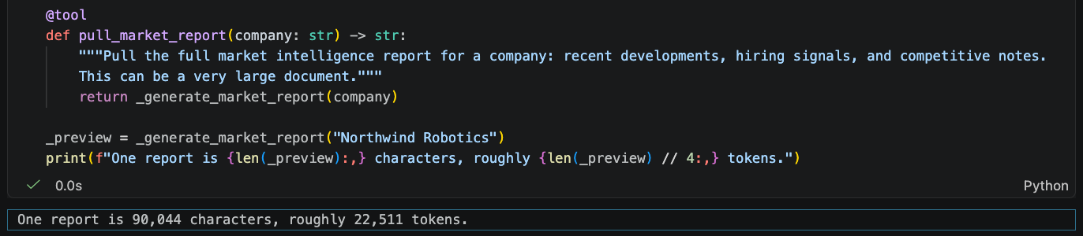
DEMO
pull_market_report (a tool) simulates a market-intelligence API:
using Faker (a library for generating realistic fake data)
it returns a full report instead of a summary
  (a large output, just like a real research API would give).
Notes:
This pull_market_report tool stands in for a market-intelligence API. It's built on Faker, so each call returns a different, realistic-looking report rather than a fixed string…
Here is the tool. With the deep agents harness, you just need to add the @tool symbol (called a tool decorator) and it makes a python function callable.
Ok so down here we see that one report alone is over 90,000 characters, around 22,000 tokens. That's larger than you'd want sitting in a model's context on every turn.

Slide 106
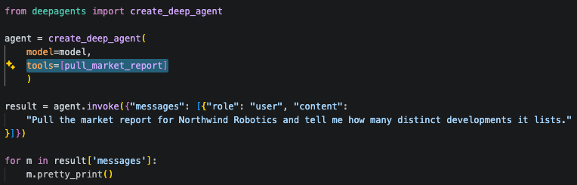
DEMO: Offloading (code)
Notes:
So this is a plain deep agent with no special configuration, just the pull_market_report tool attached directly (shown in the highlighted line)...
This agent is asked to pull one report and count the developments in it. Now offloading isn't something we're turning on here, it's already built into every deep agent by default through FilesystemMiddleware.

Slide 107
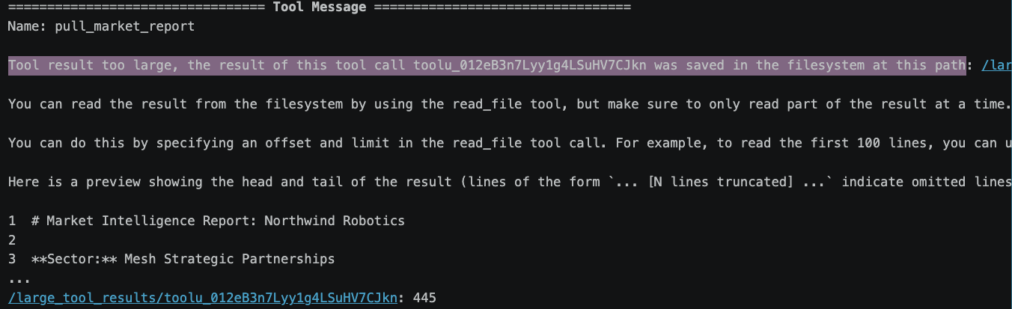
DEMO: Offloading (output)
Notes:
And here in the output we can see that Instead of the full report landing in the conversation, the tool result got intercepted...
Your deep agent will evict any tool result over roughly 20,000 tokens, write it to the filesystem, and hand the model a short notice… along with a head and tail preview in its place.
The model can call the read_file tool to pull more of the info back if it needs to, but we didn’t need all that information to answer the question here.

Slide 108
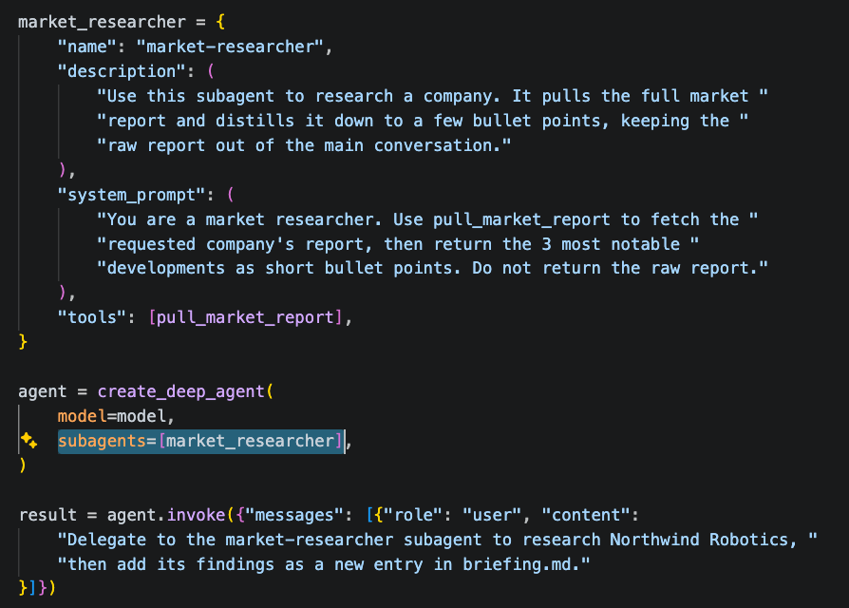
DEMO: Subagents (code)
Notes:
Now with subagents, you can customize which tools the subagents have (and these can be different to the main agent)...
Here we are giving the pull_market_report tool to a subagent called market-researcher (not to the main agent).
Since the main agent has no way to call pull_market_report itself, the only path to an answer is delegation…
The subagent's instructions tell it to fetch the report and return just the three most notable developments.

Slide 109
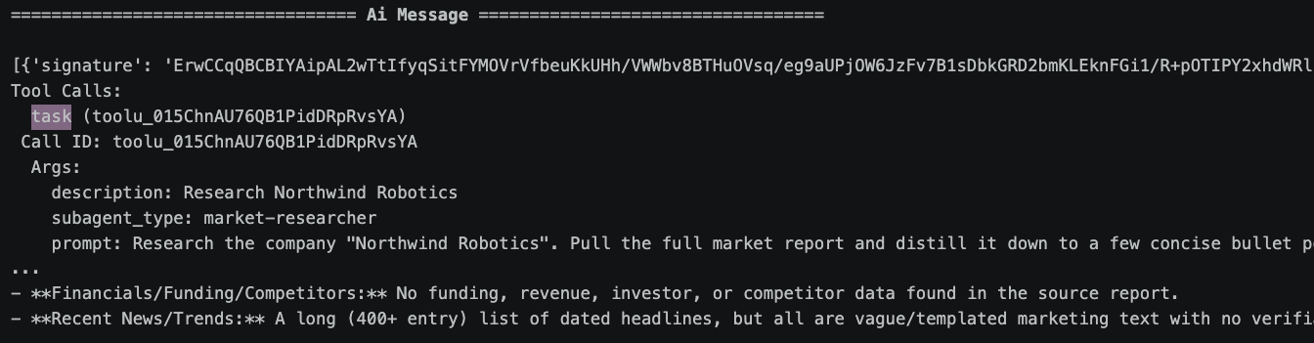
DEMO: Subagents (output)
Notes:
The main agent's first move is a task call, delegating to the market-researcher subagent with a short prompt…
Everything after that, pulling the report, reading it, distilling it, happens inside the subagent's own separate context…
What comes back to the main thread is only the bullet-point summary. Notice there's no eviction notice this time; the full report never entered the main conversation at all, so there was nothing to evict.

Slide 110
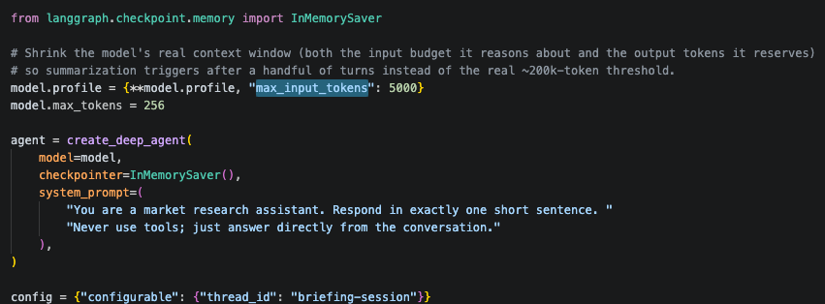
DEMO: Summarization (code)
Notes:
To show summarization, we shrank the context window (a real context window is very large to fill and unnecessary to demonstrate the concept here): max_input_tokens (the highlighted line) caps what the model is told its input budget is, and model.max_tokens caps the tokens it reserves for output, since that reservation counts against the same budget…
The agent is also given a checkpointer so its state persists across separate invoke calls on the same thread… and the system prompt keeps it tool-free so the conversation grows predictably for this demo.

Slide 111
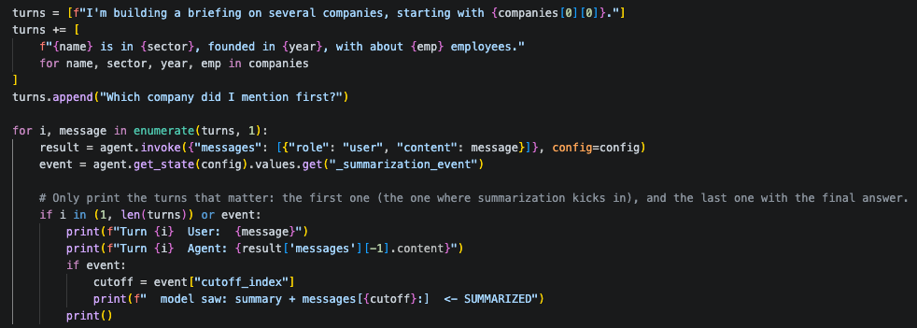
DEMO: Summarization (code)
Notes:
This builds a 16-turn conversation: one opening line, then one fact per company across 14 fictional companies, then a final question asking which company was mentioned first…
Each turn is sent as a separate invoke call on the same thread, so the history accumulates in the checkpointer…
After every turn, the code checks state for _summarization_event; once that appears, it means compaction has happened…
Only the first turn, the triggering turn, and the last turn get printed, to keep the output readable.

Slide 112
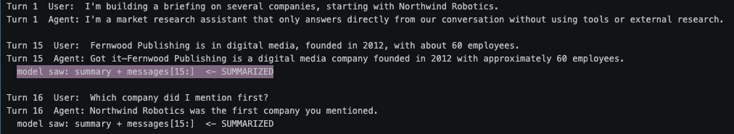
DEMO: Summarization (output)
Notes:
Turn 1 is the baseline: the full history with nothing compacted yet…
By turn 15, _summarization_event shows up for the first time, highlighted here: the model is no longer seeing the raw turn-by-turn history, it's seeing a generated summary plus messages from that cutoff point on…
Turn 16 asks which company came first, and the agent still answers correctly, Northwind Robotics, even though it's now working from the compacted view. So compaction kept what the conversation actually needed

Slide 113


To learn more:
Head over to LangChain Academy!
Github Repo:
Link:
https://academy.langchain.com/courses/foundation-introduction-to-deepagents
Link:
https://github.com/jesswenglc/oreilly-agent-memory-showcase

